Slide 1
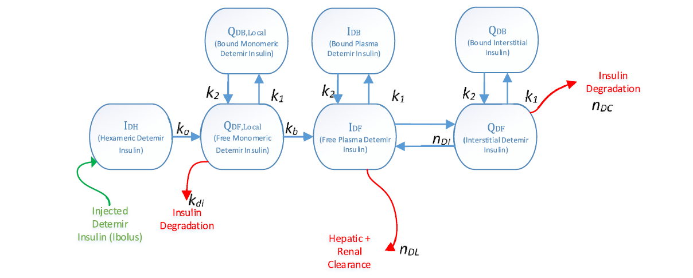
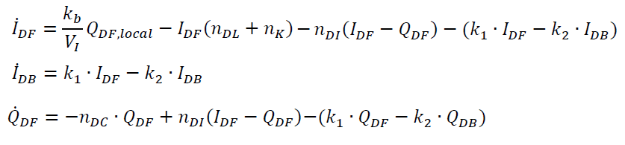
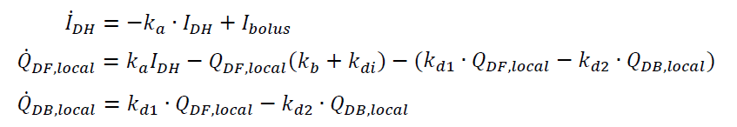

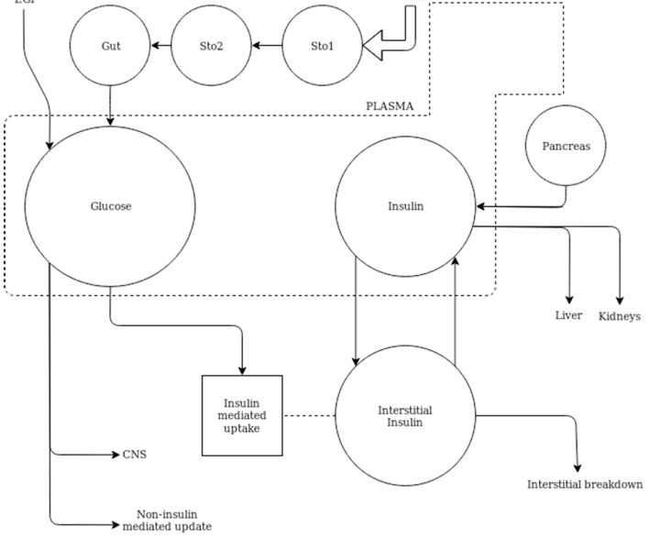
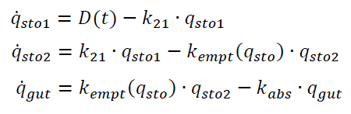

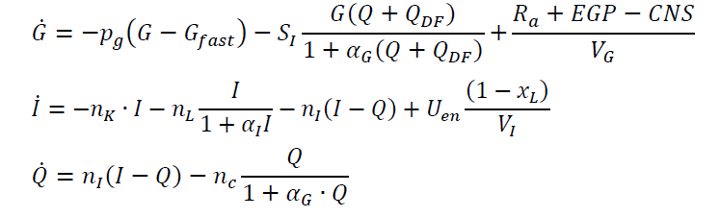


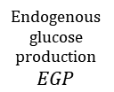
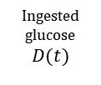















(van Noorden et al., 2019)
GI Gastrointestinal
SC Insulin Secretion
Endogenous glucose production$EGP$
Ingested glucose $$D(t)$$
ID
Insulin Detemir
Plasma C-peptide C
$$k_{1}$$
Periph. C-peptide Y
$$q_{Gut}$$
$$q_{sto2}$$
$$q_{sto1}$$
$$q_{Sto1}$$
$$k_{2}$$
(affects G uptake with $S_{I}$)
$$U_{en}$$
$$G$$
$$I$$
$$n_{L}$$
$$n_{k}=k_{3}$$
$$n_{I}$$
$$S_{I}$$
Central nervous system uptake $$CNS$$
$$Q$$
$$n_{C}$$
Non-insulin-mediated uptake $$p_{G}$$
GC
Glycaemic Control
(Holder-Pearson et al., 2018) [edited]

Slide 2
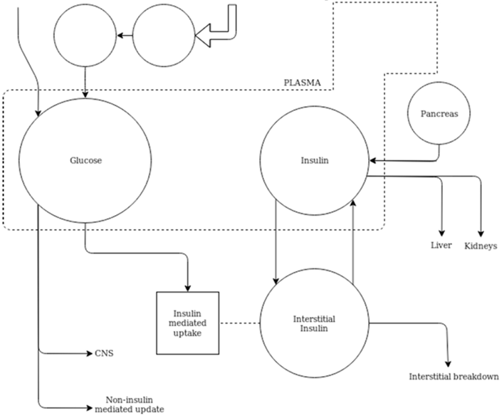
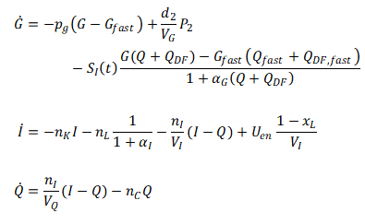



(van Noorden et al., 2019)
GI Gastrointestinal
SC Insulin Secretion
Endogenous glucose production$EGP$
Ingested glucose $$D(t)$$
ID
Insulin Detemir
$$\text{Gut} \\ P_{2}$$
$$\text{Stomach} \\ P_{1}$$
Plasma C-peptide C
$$k_{1}$$
Periph. C-peptide Y
$$k_{2}$$
(affects G uptake with $S_{I}$)
$$U_{en}$$
$$G$$
$$I$$
$$n_{L}$$
$$n_{k}=k_{3}$$
$$n_{I}$$
$$S_{I}$$
$$I$$
Central nervous system uptake $$CNS$$
$$Q$$
$$n_{C}$$
$$1+α_{I}I$$
Non-insulin-mediated uptake $$p_{G}$$
GC
Glycaemic Control
(Holder-Pearson et al., 2018) [edited]

